Slide 1

VIVEKANAND COLLEGE FOR ADVANCED
COMPUTER AND INFORMATION SCIENCE SURAT
AFFILIATED TO
VEER NARMAD SOUTH GUJARAT UNIVERSITY,
SURAT
SEMINAR REPORT
ON
WETHER MONTERING SYSTEM ARDUINO
PRESENTED BY:
GUIDED BY: DARSHAN PATEL DR.MEGHA VIRAL POLISHWALA

Slide 2

Weather Monitoring System Using Arduino
Prepared by :- Patel darshan
Exam No :
Guided by : Dr.Megha Viral polishwala

Slide 3

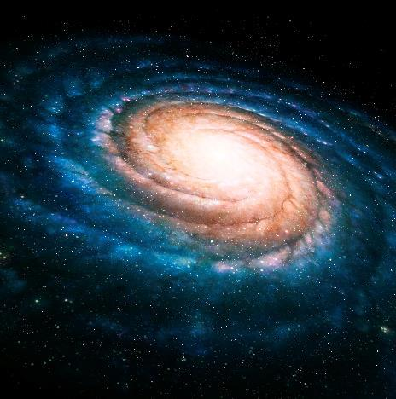


Content
Introduction Block Diagram
Objective Advantages
What is IOT? Applications
Components Future scope
Conclusion

Slide 4
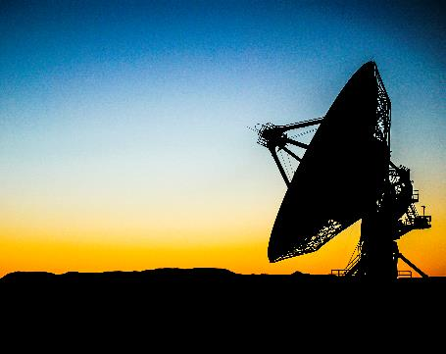
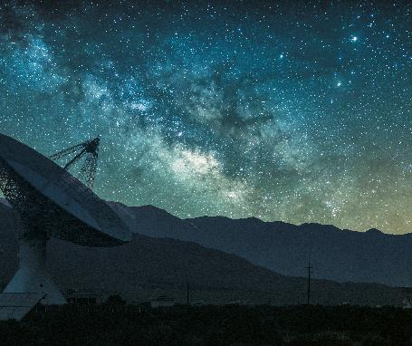

Introduction
Weather Monitoring system is a part of the term IOT.
Weather monitoring system is an essential practical implementation of the concept Internet of things,it involves sensing and recording various weather parameters and using them for future analysis.
The implemented system consists of a microcontroller (Arduino Nano) as a main processing unit for the entire system and all the sensor can be connected with the microcontroller.

Slide 5
Introduction(con…)
Weather monitoring system is a system that involves acquiring weather and environment data using advanced electronic sensors and display it on the LCD screen.
This system uses Temperature,Humidity,C02 as well as rain detector sensor to monitor weather and provide live reporting of weather statistics.
The aim of this technology is achieved by technologies such as Internet of things and cloud.

Slide 6
Objective
This system is designed because it is easy to monitor local weather conditions in real time from any where in the world.
The system is also used For storing weather and environment data for short and long term for studying weather pattern changes and to understand how human induced climate change affected your local weather.
It is also easy to setup a system for monitoring local atmospheric conditions and microclimates for weather forecasting and prediction.
This system also helps the user to plan their day to day activities.

Slide 7
What is IOT?
The Internet of Things “IOT” describes the network of physical objects that are embedded with sensors, software, and other technologies for the purpose of connecting and exchanging data with other devices and systems over the internet.
Over the past few years, IoT has become one of the most important technologies of the 21st century.
We uses IOT devices in our daily life as well for instance, cars , kitchen appliances.
We can connect these object to the internet via embedded devices and seamless connection is also possible between people.

Slide 8
What technologies have made IOT possible?
Access to low cost , low power sensor technology
Connectivity
Cloud computing platforms
Machine learning and analytics
Artificial intelligence (AI)

Slide 9
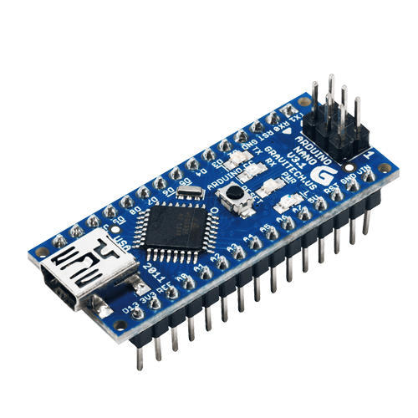

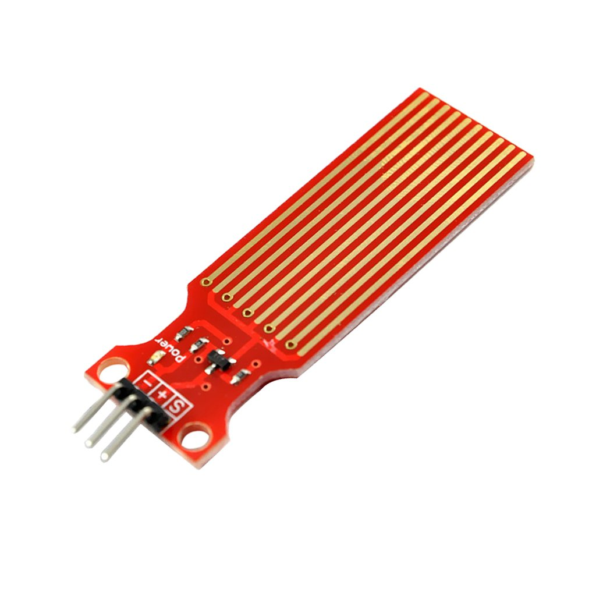
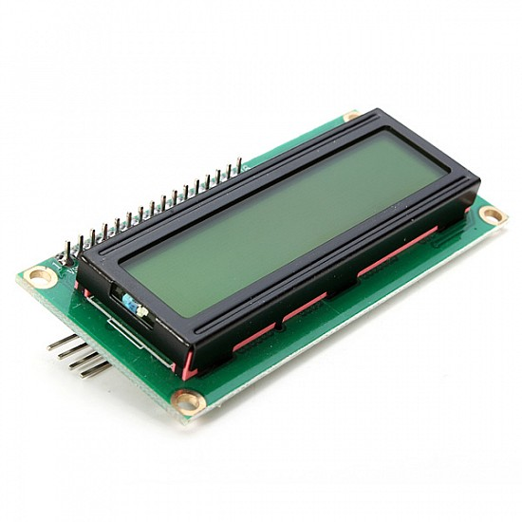
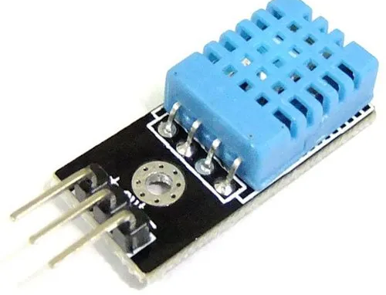
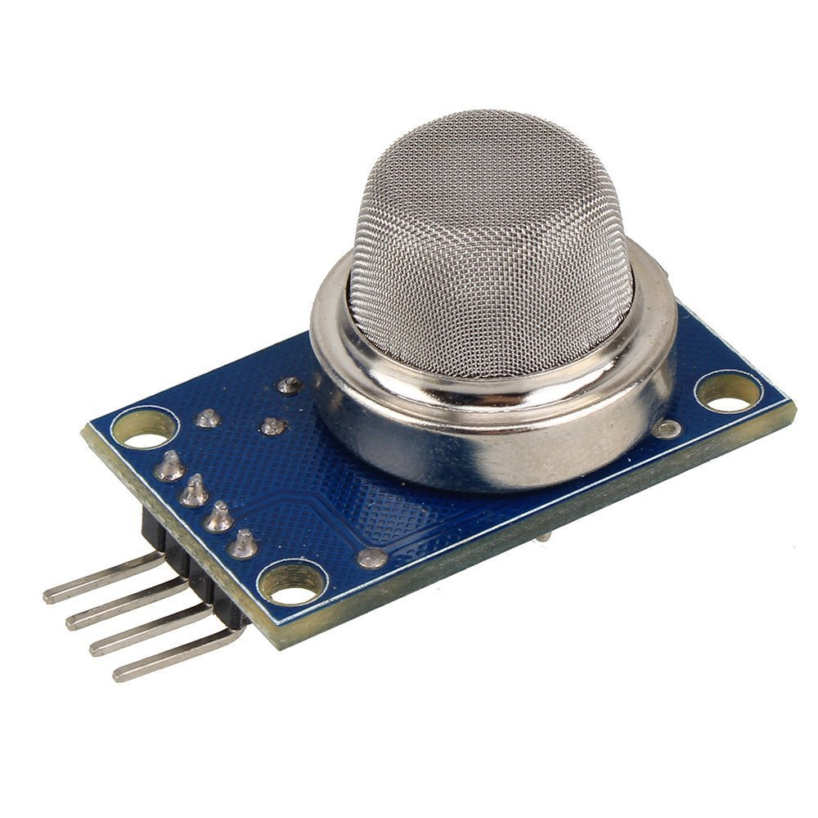


Components
Arduino Nano
DHT11
Rain Detector
MQ-135
I2C Display

Slide 10
Arduino Nano
The Arduino Nano is a small, complete, and breadboard-friendly board based on the ATmega328P.
We can say that it is a heart of the system because it is equipped with 30 male I/O headers which can be programmed using Arduino software IDE.
All the required code which is necessary for the working of the system is stored in Arduino board.
Arduino board can be powered through a type B mini USB cable.

Slide 11
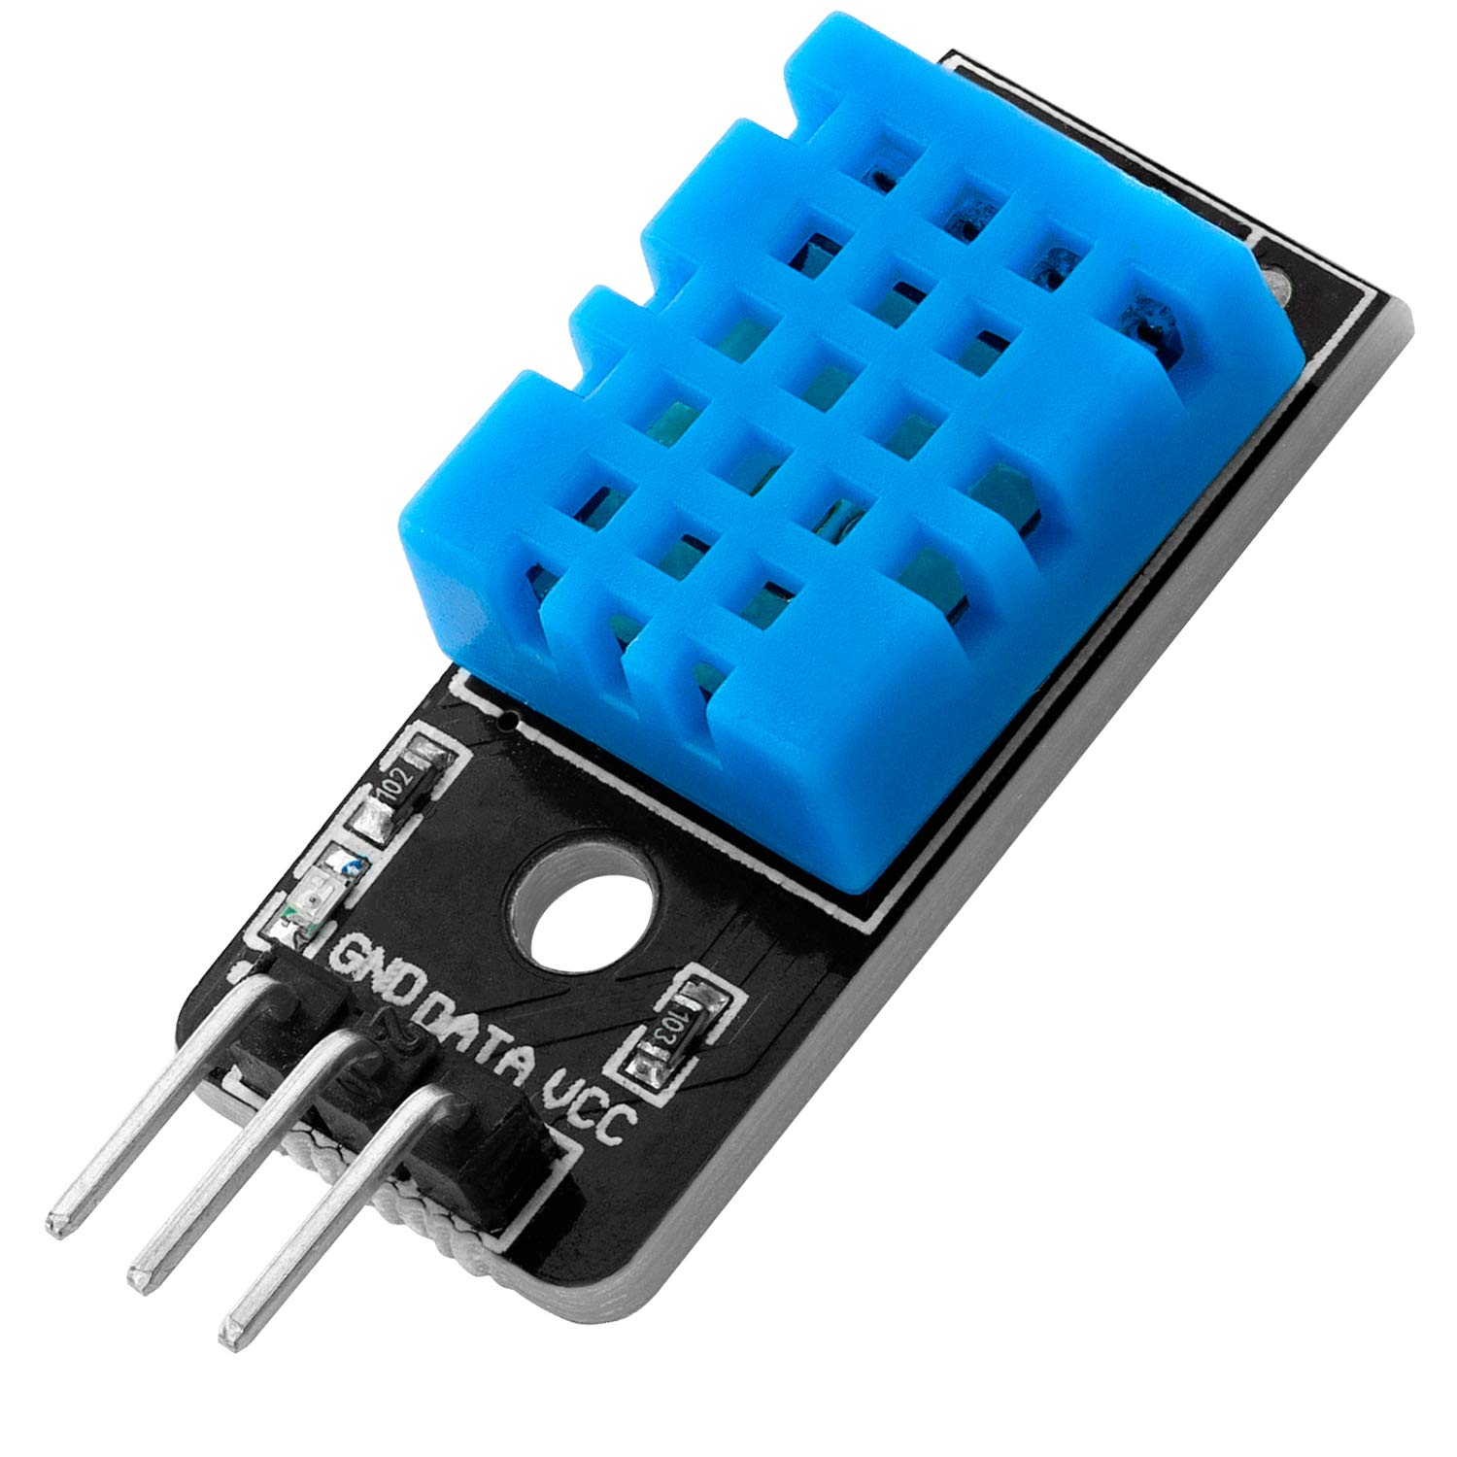
DHT11
DHT11 is a low-cost digital sensor for sensing temperature and humidity.
DHT11 sensor consists of a capacitive humidity sensing element and a thermistor for sensing temperature.
The humidity sensor is used as a preventive measure in homes where people are affected by humidity.
It’s compact size and sampling rate made this sensor popular among hobbyists.

Slide 12
Rain Sensor
Nowadays, conserving water as well as its proper usage is essential in everyone’s life.
Here is a sensor namely rain sensor which is used to detect the rain.
These sensors are mainly used in the field like automation, irrigation and automobiles.
It works like a switch and the working principle of this sensor is, whenever there is rain, the switch will be normally closed.

Slide 13
MQ-135
An MQ135 air quality sensor is one type of MQ gas sensor used to detect, measure, and monitor a wide range of gases present in air like ammonia, alcohol, smoke, carbon dioxide, etc.
Preheating of 20 seconds is required before the operation, to obtain the accurate output.
It operates at a 5V of power supply , which is comparatively higher than other sensors.

Slide 14
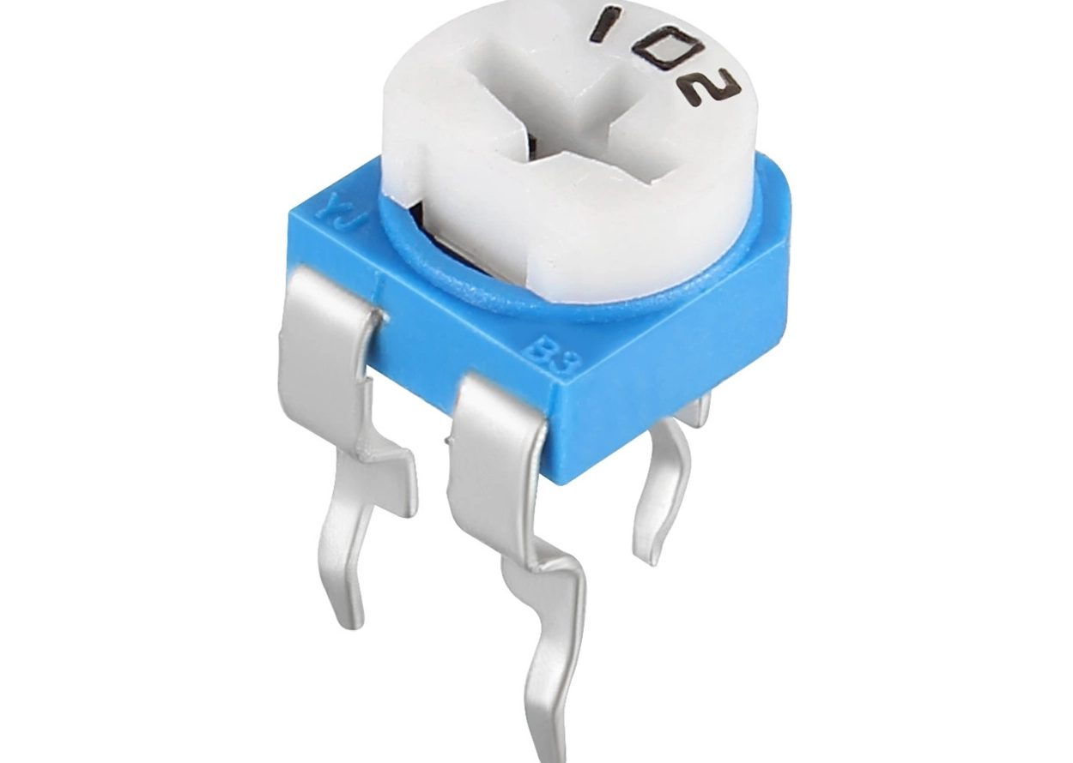
I2C Display Potentiometer
I2C Display is used to display the data gathered by sensors.
It is easy to use because it only needs Five connections with Arduino nano.
After the successful connection we can use it to display the data.
The potentiometer is essentially a voltage divider used for measuring electric voltage.
Potentiometers are commonly used to control electrical devices such as volume controls on audio equipment.

Slide 15
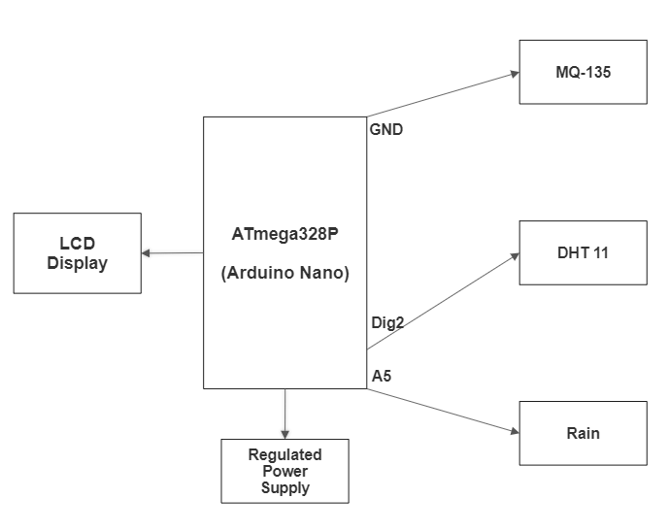
Block Diagram

Slide 16
Advantages
High-quality receiving data
Less power consumption
Accuracy is High
It requires less human intervention
Smart way to monitor Environment
The low cost and efforts are less in this system

Slide 17
Applications
The weather forecasting plays very important role in the field of agriculture.
It is also helpful at places like volcano and rain forests.
It is quite difficult for a human being to stay for longer time at such places.
It is also applicable at Chemical plants as it is difficult for humans to stay at such places for longer time.

Slide 18
Future Scope
One can implement a few more Features and connect it to the satellite as a global feature of this system.
One can also Add more sensor to monitor other environmental parameters such as Pressure and Oxygen Sensor.
It can also be implemented in hospitals or medical institutes for the research & study in “Effect of Weather on Health and Diseases”, hence to provide better precaution alerts.

Slide 19
Conclusion
By keeping the weather station in the environment for monitoring enables self-protection to the environment.
To protect the public health from pollution, this model provides efficient and low cost solution for continues monitoring of environment

Slide 20

Thank You

